Slide 1

“Everyone like birds. What wild creature is more accessible to our eyes and our ears, as close to us and everyone in the world, as universal as a bird?” David Attenborough
NI saddleback voice

Slide 2
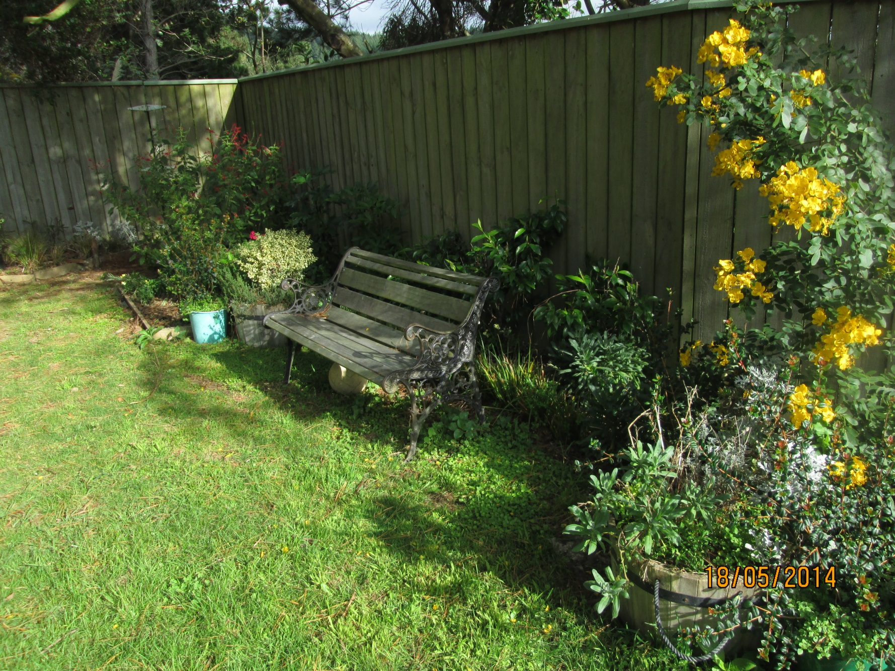

Slide 3
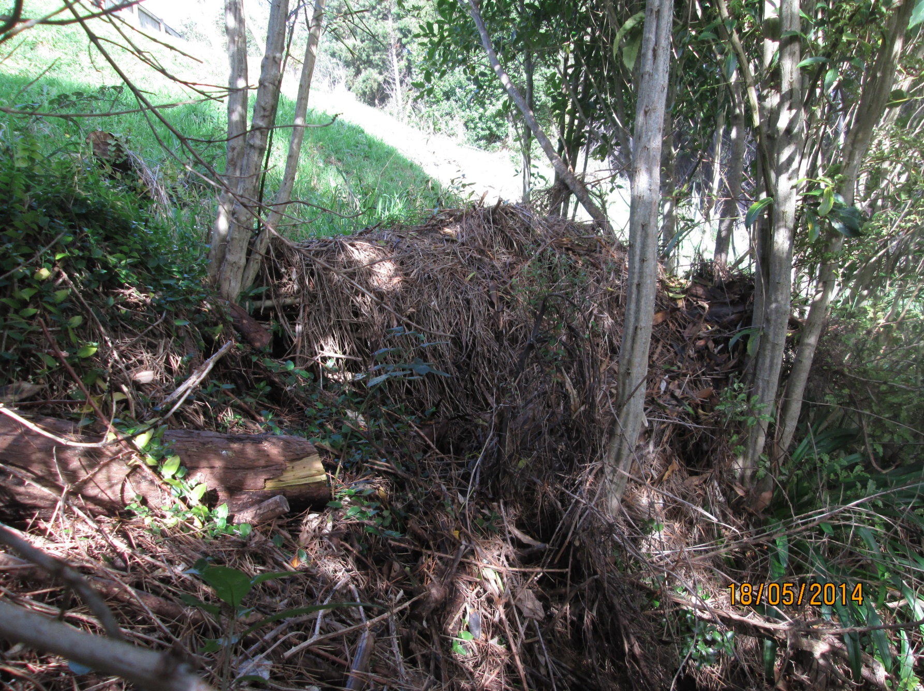

Slide 4
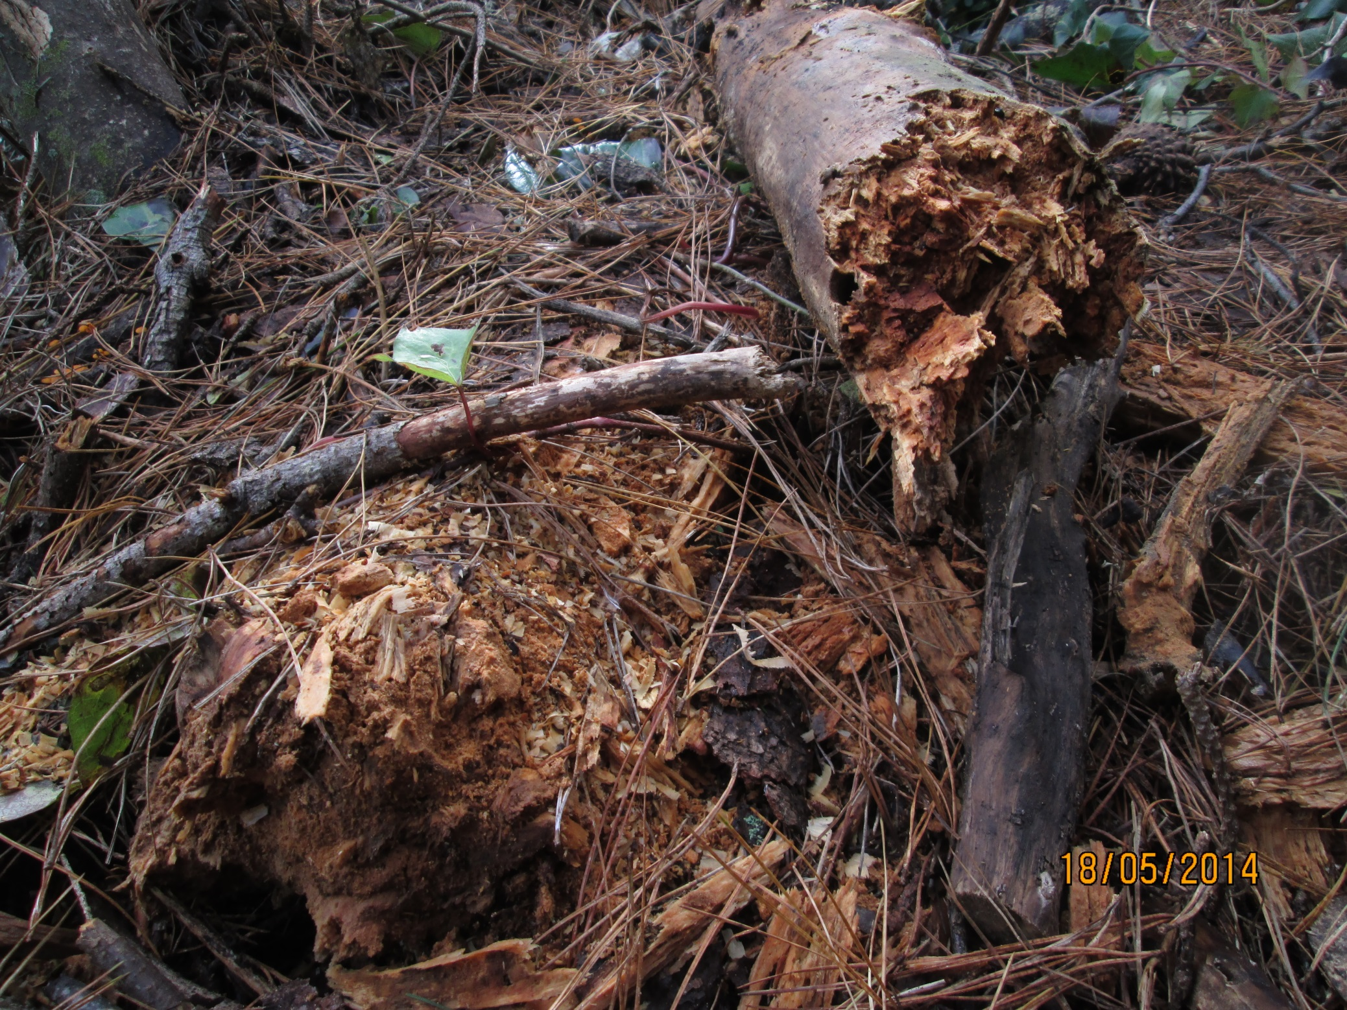

Slide 5
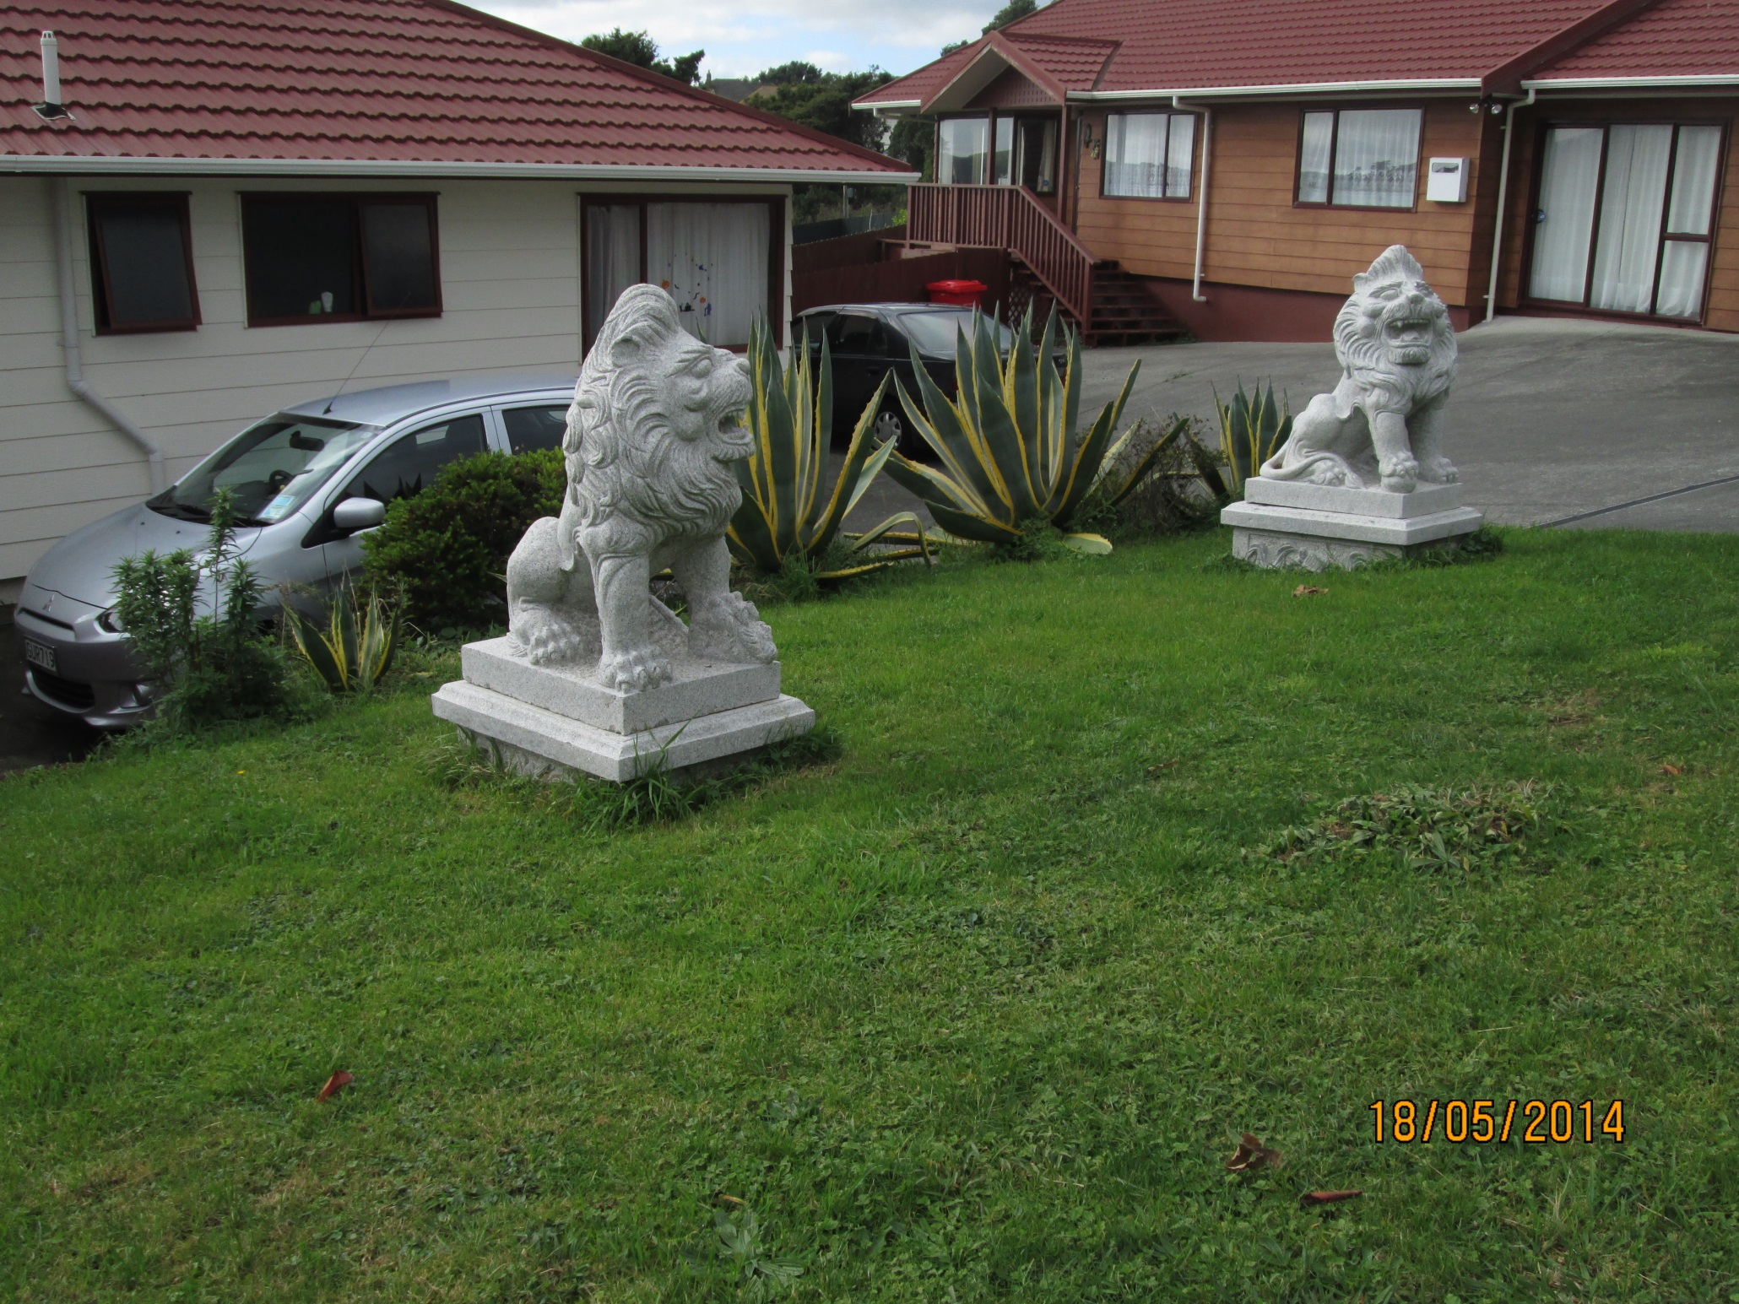

Slide 6
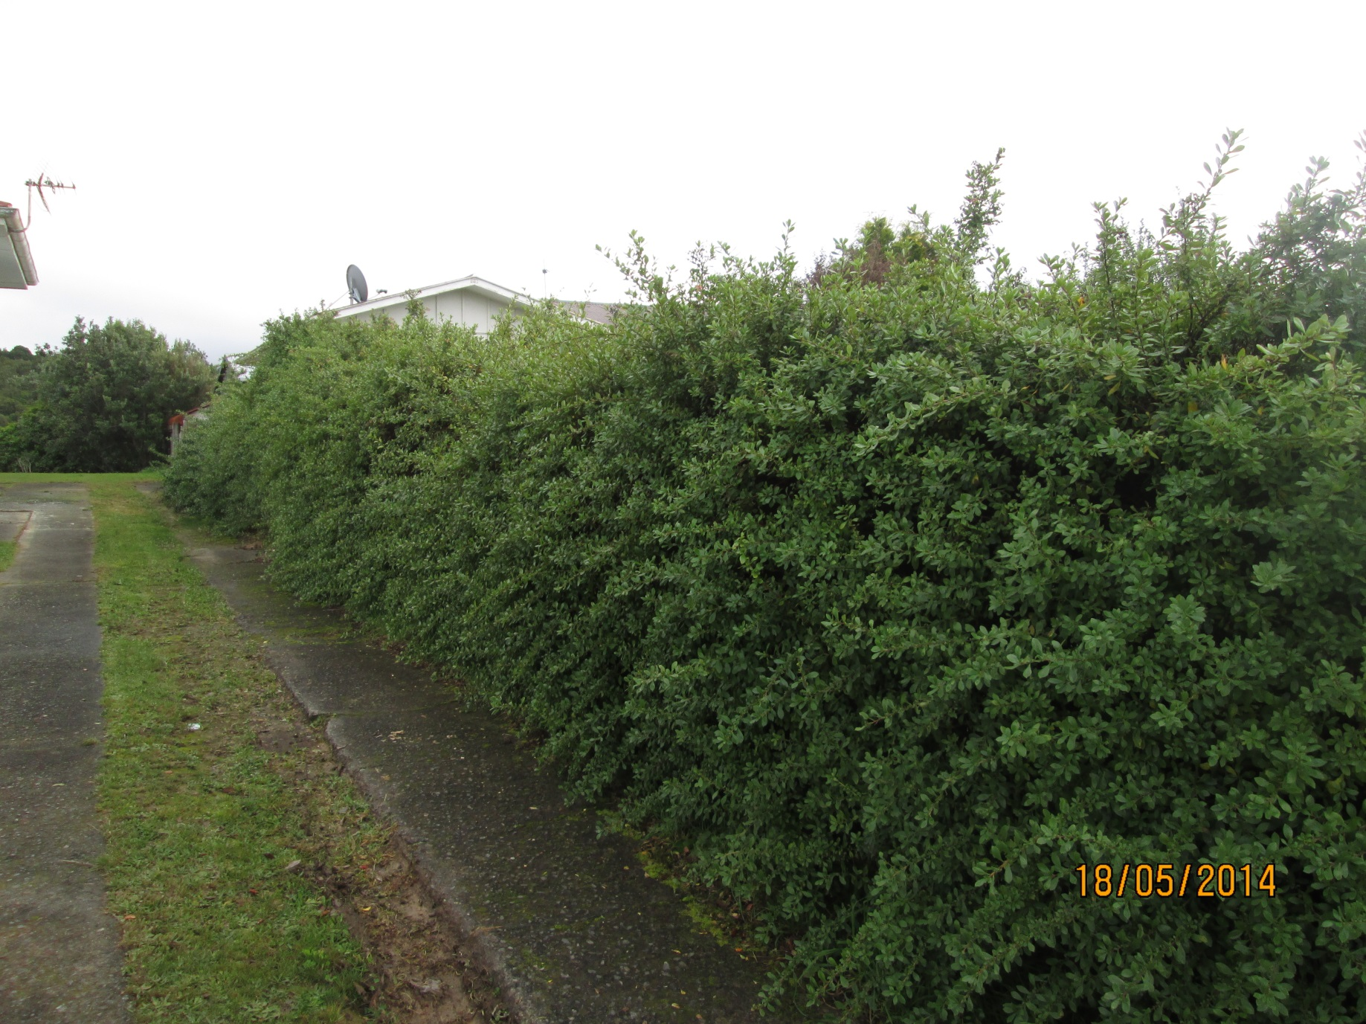

Slide 7
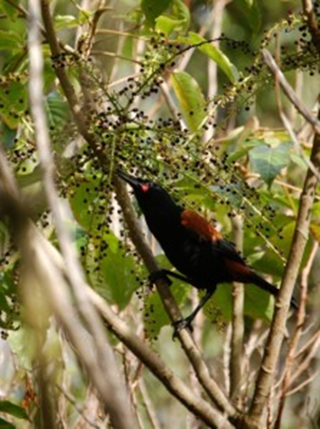
The decline of the Saddleback STORY

Slide 8
Nationally critical :::Nationally endangered
Nationally critical black stilt/kakī
Black robin
Black stilt/kakī
Bounty Island shag
Campbell Island snipe
Campbell Island teal
Chatham Island oystercatcher
Chatham Island pigeon, parea
Chatham Island taiko
Codfish Island South Georgian diving petrel
Eastern rockhopper penguin
Grey duck
Grey-headed mollymawk
Haast tokoeka
Kakapo
Kermadec white-faced storm petrel
New Zealand fairy tern
New Zealand shore plover
Orange-fronted parakeet
Rowi, Okarito brown kiwi
South Island brown teal
Southern New Zealand dotterel
Takahe
White heron
White tern
New Zealand birds
The nationally endangered bittern
Bittern
Black-billed gull/tarāpuka
Black-fronted tern/tarapirohe
Chatham Island shag
Chatham Island tomtit
Chatham Island tui
Forbes’ parakeet
King shag
Masked (blue-faced) booby
Pitt Island shag
Red-tailed tropicbird
South Island kaka
Southern falcon
Stitchbird
White-bellied storm petrel

Slide 9
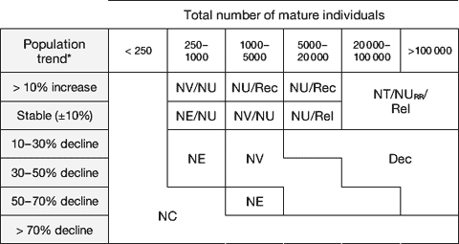

Slide 10
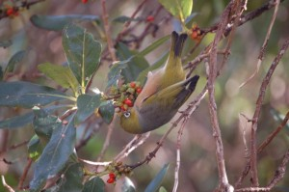
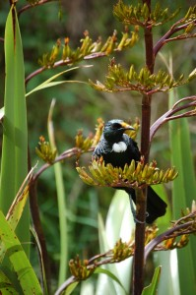
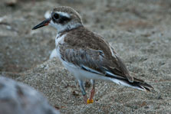
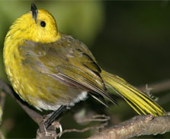
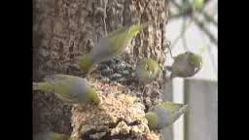
THE VISION
Restoring the Dawn Chorus was the Department of Conservation‘s five year strategic business plan.
. It set out the goals, and directions 1998 - 2002.

Slide 11
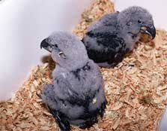
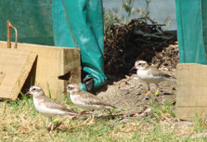
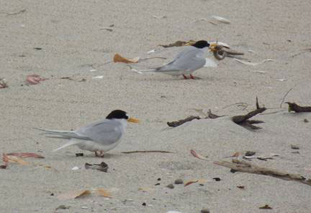
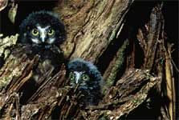
South island Kaka
Nz Shore plover
Fairy tern
Morepork chicks

Slide 13
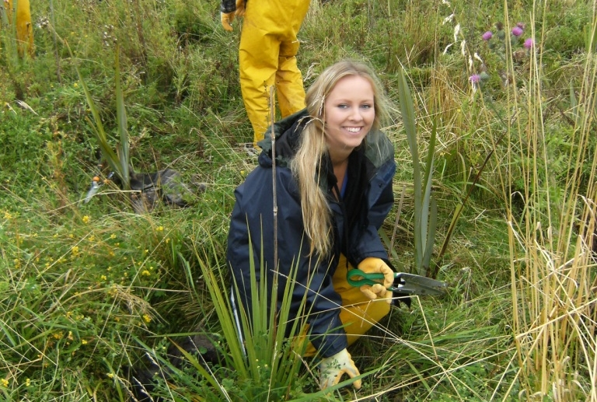
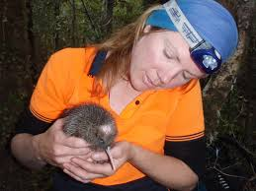
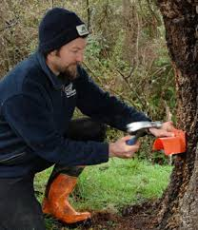
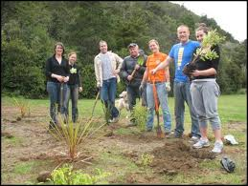

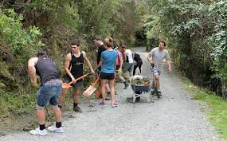
YOU CAN HELP !!

Slide 14
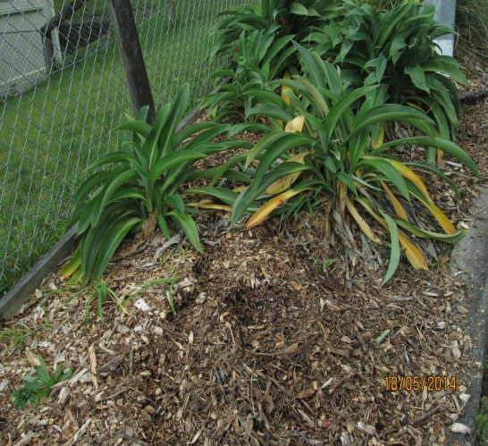
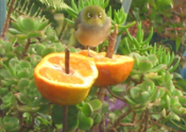
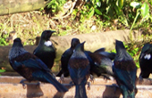
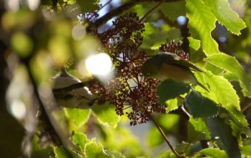
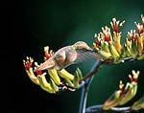
fruit
Artificial nectar
insects
berries
Real nectar

Slide 16
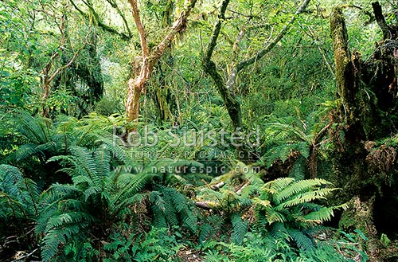
THE PLAN FOR YOUR GARDEN Start by planning the eventual heights and widths of plants you want and select plants to suit. You can easily grow them yourself from seeds or cuttings or buy them from a plant nursery.
Deciduous trees (kowhai, tree fuchsia/kotukutuku Fuchsia excorticata, deciduous tree daisy Olearia hectorii, ribbonwood Plagianthus regius and mountain lacebark Hoheria lyallii) will add shade in summer but let in light in winter.

Slide 17
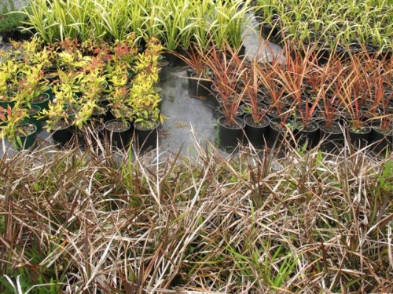
ECOSOURCE YOUR PLANTS
It is important that your plants are eco-sourced - from seeds or cuttings collected from local, wild origins. Many native plants have evolved their own distinctive forms and characteristics in different regions, and are adapted to cope with local conditions.
By planting local forms you will help preserve your area's unique botanical diversity - and your plants have better chance of thriving.

Slide 18
NOW IS GOOD
COLLECT SEEDS
Common name | Botanical name | Colour of ripe fruit/seed case | J | F | M | A | M | J | J | A | S | O | N | D
Akeake | Dodoneae viscosa | dry/brown |  |  | x | x
Broadleaf | Griselinia littoralis | dark brown |  |  | x | x | x
Cabbage tree | Cordyline australis | cream | x | x | x | x
Five finger | Pseudopanax arboreus | black |  | x | x | x | x
Fuchsia | Fuchsia excorticata | red/purple | x | x | x |  |  |  |  |  |  |  |  | x
Flax (lowland) | Phormium tenax | dry/black |  | x | x | x | x
Flax (mountain) | Phormium cookianum | dry/black |  | x | x | x | x
Honeysuckle | Knightia excelsa | dry/brown |  | x | x | x | x
Houpara | Pseudopanax lessonii | black | x | x | x | x | x | x | x | x | x | x | x | x
Kahikatea | Dacrycarpus dacrydioides | red/brown |  |  | x | x
Kamahi | Weinmannia racemosa | dry/pale brown |  | x
Kanuka | Kunzea ericoides | brown |  |  | x | x | x
Karaka | Corynocarpus laevigatus | orange | x | x | x | x
Karamu | Coprosma robusta | orange |  | x | x
Karo | Pittosporum crassifolium | green/brown | x | x | x | x |  |  |  |  |  |  |  | x
Kauri | Agathis australis | green |  |  | x
Kohekohe | Dysoxylum spectabile | green/red | x | x | x |  |  |  |  |  |  |  | x | x
Kohuhu | Pittosporum tenuifolium | green/brown |  |  |  | x | x | x
Kowhai | Sophora microphylla | dry brown | x | x | x | x | x
Lacebark | Hoheria sextstylosa | dry/brown |  |  |  |  |  | x | x | x | x | x
Lancewood | Pseudopanax crassifolius | purple | x | x | x | x
Lemonwood | Pittosporum eugenioides | black |  |  | x | x | x
Mahoe | Melicytus ramiflorus | purple |  | x | x
Manuka | Leptospermum scoparium | brown |  |  |  | x | x | x | x | x
Mapou | Myrsine australis | black | x | x | x | x |  |  |  |  |  |  |  | x
Matai | Prumnopitys taxifolia | black |  | x | x | x | x | x
Miro | Prumnopitys ferruginea | red |  |  | x | x | x | x
Ngaio | Myoporum laetum | pink/purple |  |  | x | x | x | x
Nikau | Rhopalostylis sapida | red |  |  | x | x
Pigeonwood | Hedycarya arborea | orange | x | x | x | x
Pohutukawa | Metrosideros excelsa | dry/brown |  |  |  | x | x
Pukatea | Laurelia novae-zelandiae | green |  |  | x | x | x
Puriri | Vitex lucens | red | x | x | x | x | x | x | x | x | x | x | x | x
Rangiora | Brachyglottis repanda | dry/brown | x
Rimu | Dacrydium cupressinum | red/brown |  |  |  | x | x
Tawa | Beilschmiedia tawa | purple |  |  |  | x
Taupata | Coprosma repens | orange |  |  | x | x
Titoki | Alectryon excelsus | red/black | x | x |  |  |  | x | x |  |  |  | x | x
Totara | Podocarpus totara | red/yellow |  |  |  | x | x
Wineberry | Aristotelia serrata | red/black | x | x | x | x | x

Slide 19
Monthly calendar of plants for birds
Key: | N - Nectar | FS - Fruit and seeds |  |  |  |  |  | FSN - Fruit, seeds and nectar
Common name | Botanical name | J | F | M | A | M | J | J | A | S | O | N | D
Akatea | Metrosideros fulgens |  |  | N | N | N | N | N
Astelia | Astelia nervosa | N | FSN | FS | FS | FS
Cabbage tree | Cordyline australis | FS | FS | FS | FS |  |  |  |  |  |  | N
Fivefinger* | Pseudopanax arboreus |  | FS | FS | FS | FS
Flax (mountain) | Phormium cookianum | N |  |  |  |  |  |  |  |  | N | N | N | no seeds
Flax (lowland) | Phormium tenax | N |  |  |  |  |  |  |  |  |  | N | N
Hinau | Elaeocarpus dentatus | FS | FS | FS | FS | FS |  |  |  |  |  |  | FS
Kahikatea | Dacrycarpus dacrydiodes |  |  | FS | FS | FS
Kaikomako* | Pennantia corymbosa | FS | FS | FS | FS |  |  |  |  |  |  | N | N
Kakabeak | Clianthus puniceus |  |  |  |  |  |  |  |  |  |  | N | N
Kanono* | Coprosma grandifolia |  | FS | FS | FS | FS
Karaka*+ | Corynocarpus laevigatus |  | FS | FS | FS
Key: | N - Nectar | FS - Fruit and seeds |  |  |  |  |  | FSN - Fruit, seeds and nectar
Monthly calendar of plants for birds
Key: | N - Nectar | FS - Fruit and seeds |  |  |  |  |  | FSN - Fruit, seeds and nectar
Common name | Botanical name | J | F | M | A | M | J | J | A | S | O | N | D
Akatea | Metrosideros fulgens |  |  | N | N | N | N | N
Astelia | Astelia nervosa | N | FSN | FS | FS | FS
Cabbage tree | Cordyline australis | FS | FS | FS | FS |  |  |  |  |  |  | N
Fivefinger* | Pseudopanax arboreus |  | FS | FS | FS | FS
Flax (mountain) | Phormium cookianum | N |  |  |  |  |  |  |  |  | N | N | N | no seeds
Flax (lowland) | Phormium tenax | N |  |  |  |  |  |  |  |  |  | N | N
Hinau | Elaeocarpus dentatus | FS | FS | FS | FS | FS |  |  |  |  |  |  | FS
Kahikatea | Dacrycarpus dacrydiodes |  |  | FS | FS | FS
Kaikomako* | Pennantia corymbosa | FS | FS | FS | FS |  |  |  |  |  |  | N | N
Kakabeak | Clianthus puniceus |  |  |  |  |  |  |  |  |  |  | N | N
Kanono* | Coprosma grandifolia |  | FS | FS | FS | FS
Karaka*+ | Corynocarpus laevigatus |  | FS | FS | FS

Slide 20
Key: | N - Nectar | FS - Fruit and seeds |  |  |  |  |  | FSN - Fruit, seeds and nectar
Common name | Botanical name | J | F | M | A | M | J | J | A | S | O | N | D
Karamu* | Coprosma robusta |  | FS | FS | FS | FS | FS |  |  |  |  |  |  | no nectar
Karamu* | Coprosma lucida | FS | FS | FS | FS
Karamu* | Coprosma rhamnoides |  | FS | FS | FS |  |  |  |  |  |  |  |  | M?F?
Kawakawa+ | Macropiper excelsum | FS | FS
Kohekohe+ | Dysoxylum spectabile |  |  |  |  | N | N | N | N
Kohuhu | Pittosporum tenuifolium | N | FS | FS | FS | FS |  |  |  |  | N | N | N
Kotukutuku* | Fuchsia excorticata | FS | FS | FS |  |  |  |  | N | N | N | N | FSN
Korokio | Corokia cotoneaster |  | FS | FS | FS |  |  |  |  | N | N | N
Kowhai | Sophora microphylla |  |  |  |  |  |  |  |  | N | N | N
Mahoe*+ | Melicytus ramiflorus |  | FS | FS | FS
Mapou | Myrsine australis |  |  | FS | FS | FS | FS | FS | FS | FS | FS
Miro | Prumnopitys ferruginea |  |  | FS | FS | FS | FS
Native broom | Carmichalia williamsii | N | N | N
Northern rata | Metrosideros robusta | N | N | N | N |  |  |  |  |  |  |  | N
NZ blueberry | Dianella nigra | FS | FS |  |  |  |  |  |  |  |  | FS | FS

Slide 21
Key: | N - Nectar | FS - Fruit and seeds |  |  |  |  |  | FSN - Fruit, seeds and nectar
Common name | Botanical name | J | F | M | A | M | J | J | A | S | O | N | D
Pate+ | Schefflera digitata |  |  | FS | FS
Pigeonwood*+ | Hedycarya arborea | FS | FS | FS | FS |  |  |  |  |  |  | FS | FS
Pohutukawa+ | Metrosideros excelsa | N |  | FS | FS | FS |  |  |  |  |  | N | N
Puriri+ | Vitex lucens | FSN | FSN | FSN | FSN | FSN | FSN | FSN | FSN | FSN | FSN | FSN | FSN
Putaputaweta | Carpodetus serratus |  |  | FS | FS | FS
Rewarewa | Knightia excelsa |  |  |  |  |  |  |  |  | N | N | N | N
Rimu* | Dacrydium cupressinum |  |  | FS | FS | FS
Taraire | Beilschmiedia taraire |  |  |  | FS | FS
Tarata* | Pittosporum eugenoides |  |  | FS | FS | FS |  |  |  |  | N | N | N
Taupata+ | Coprosma repens | FS | FS | FS
Tawa | Beilschmiedia tawa |  |  | FS | FS
Titoki+ | Alectryon excelsus | FS | FS |  |  |  |  |  |  |  | FS | FS | FS
Totara | Podocarpus totara |  |  | FS | FS
Wharangi+ | Melicope ternata |  | FS | FS
Wineberry* | Aristotelia serrata | FS | FS | FS
Hanghange | Geniostoma Lingustrifolum | S | S |  |  |  |  |  |  |  | N | N | N | dry seeds
bold= Kevin C Burns" top five "School of Biological Science Victoria University

Slide 22
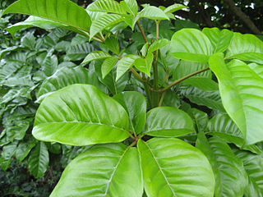
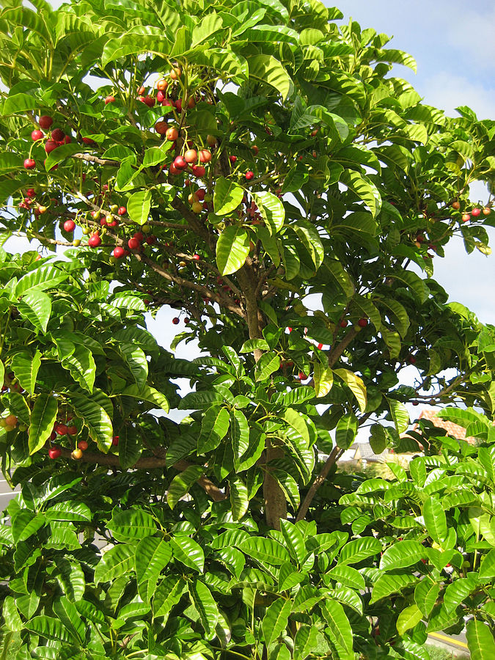
PURIRI
Fruits and flowers all year round Heavily forested for great timber and rare now.
. Kohekohe was probably the dominant vegetation cover on Kapiti Island before it was cleared in the early 19th century for cultivation and farming. The kohekohe forest on Kapiti is recovering after possums were eradicated in 1986.

Slide 23
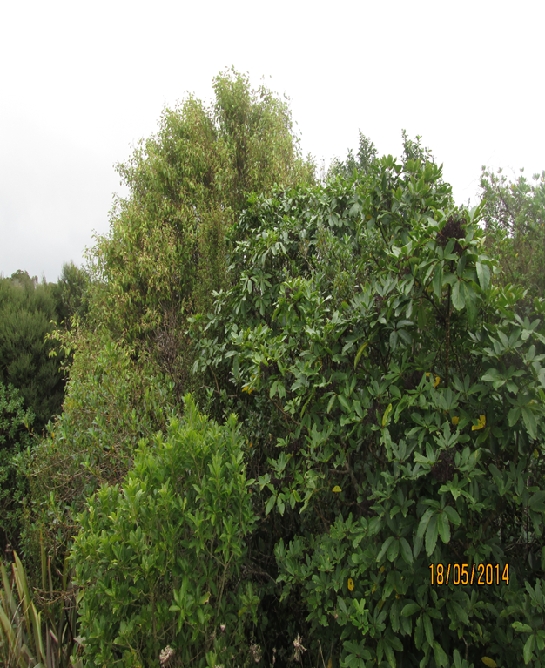
BE PREPARED TO SACRIFICE SOME SHORT LIVED PLANTS
Some plants will be "sacrificial" (fast-growing colonizers and relatively short-lived plants; koromiko, whau, native brooms, toetoe, makomako/wineberry, ngaio) when you plant. Dense planting to begin with provides cover and keeps weeds down.

Slide 24
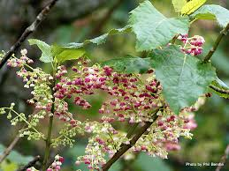
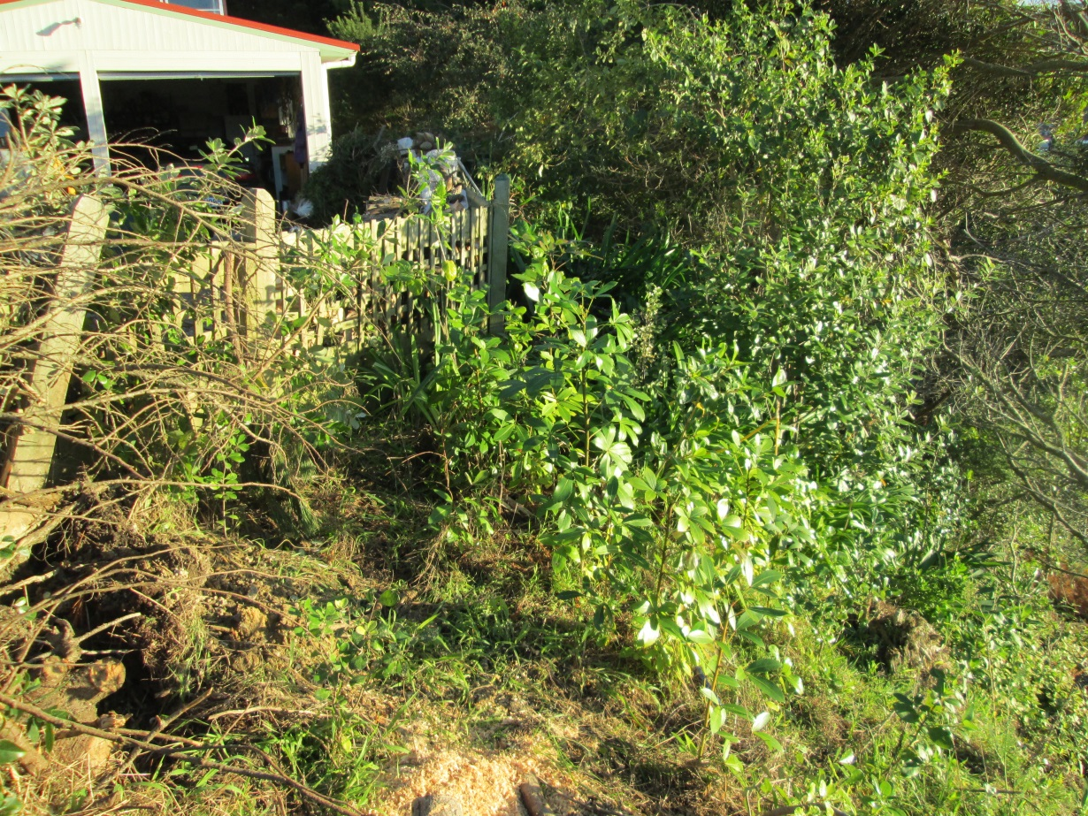
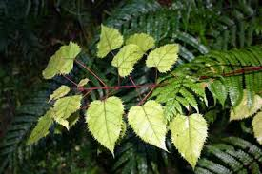
SHADE PLANTS NEED SHADE …..☺
PLAN FOR PROGRESSION ‘Some plants (most ferns, miro, matai, tawa, kawakawa, porokaiwhiri/pigeonwood, nikau palms, kohekohe) initially dislike full sun but you can still grow these plants by using the shade of fast-growing nursery plants (ngaio, tree lucerne or makomako/wineberry, karamu) or by using shade cloth for initial cover.

Slide 25
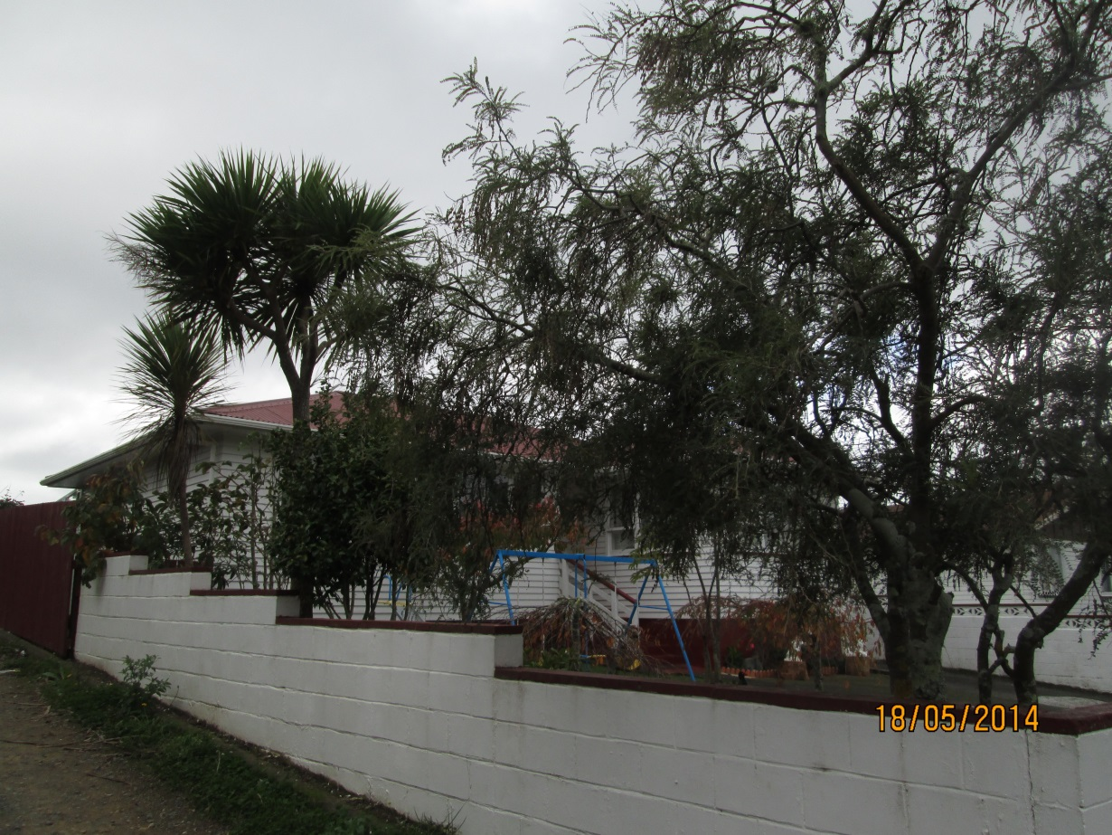
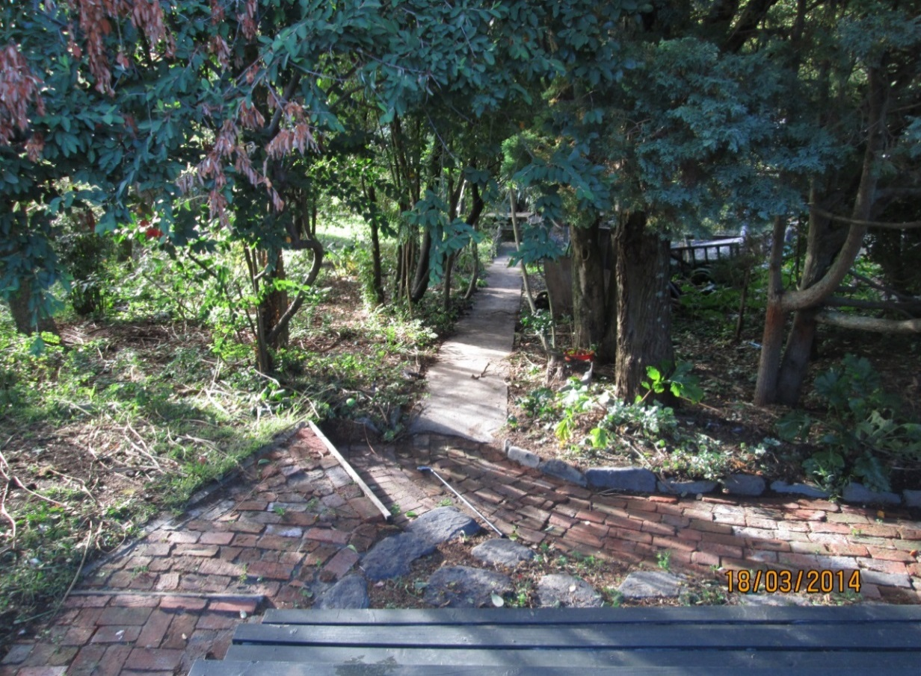
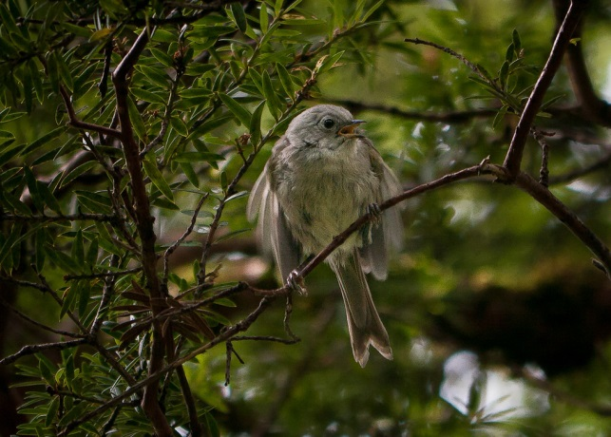
PLANT DENSELY AND THEN THIN
If you're planting a big area, dense planting is advised (approximately 1.5m apart). When plants become established, you can thin them out, creating light wells so that larger plants have enough space and light to grow and flourish
White head or mohua albida

Slide 26
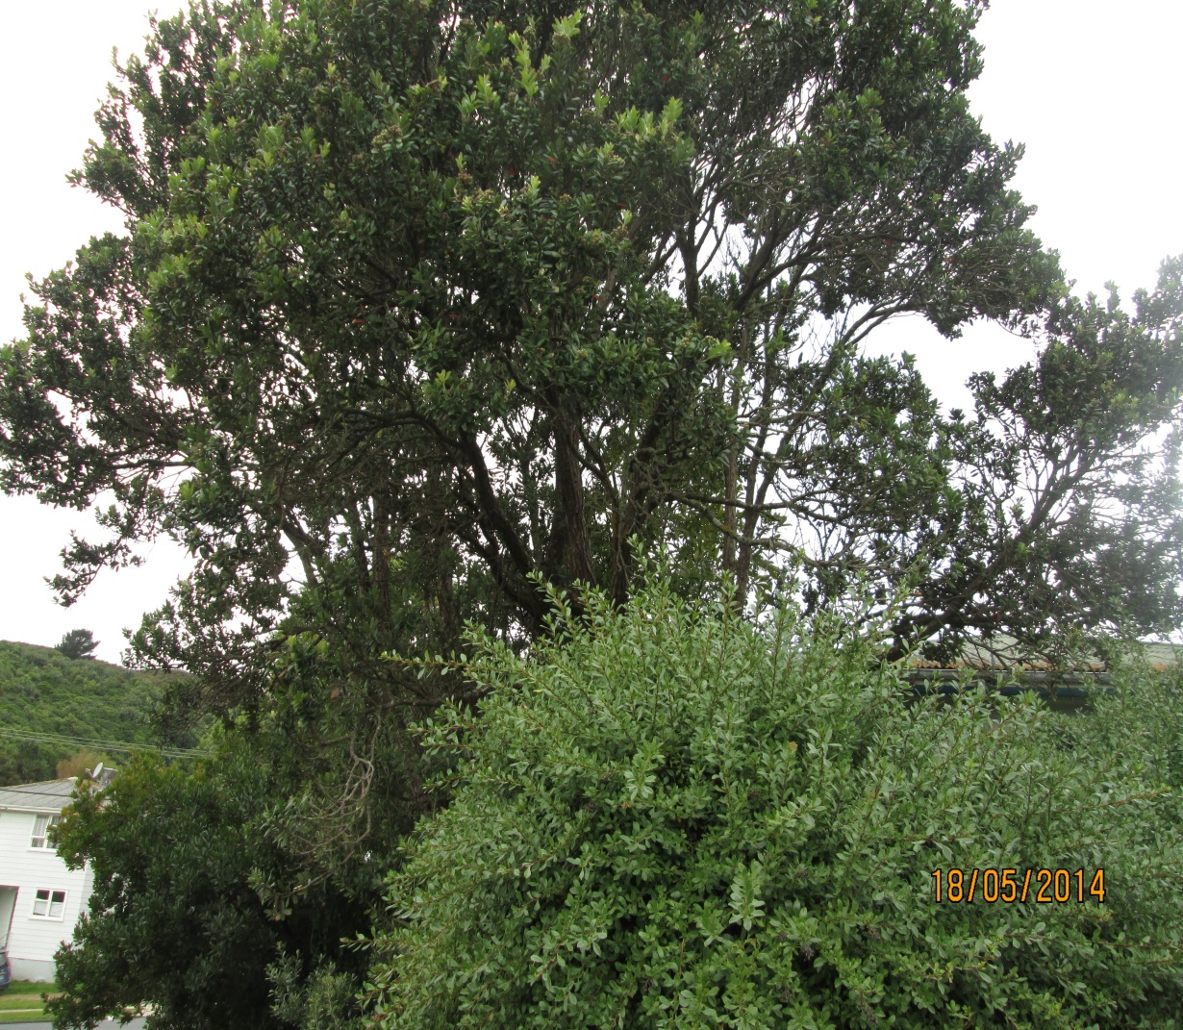
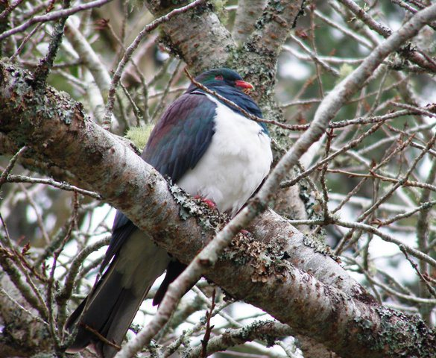
PLAN OF THE CENTURY
Plan your garden with the intention of it being there for a century or more. Short-term planning often results in pruning and cutting trees down within only a few years of planting if they shade and crowd out houses, paths, gardens and views.

Slide 27

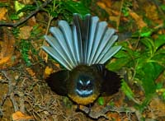
MULCH
Mulch heavily after you've planted and watered. This limits evaporation, softens the impact of heavy rainfall, helps keep weeds down, and retains and contributes nutrients.
Mulch can be in the form of compost, bark, newspaper, grass clippings, seaweed, old hessian-based carpet underfelt or a mixture of the above

Slide 28
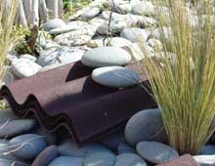
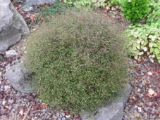
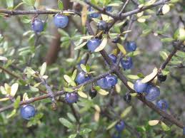
Top plants for lizards
Plants that flower close to the ground bring insects and flies within reach. As well as eating invertebrates and nectar, lizards supplement their diet with berries. Native fruits small enough to be a mouthful come from Coprosma, Muehlenbeckia, Melicytus or Gaultheria
Porcupine scrub (Melicytus alpinus)
Mikimiki or Mingimingi (Coprosma propinqua)
Thick leaved coprosma (Coprosma crassifolia)
Shrubby tororaro (Muehlenbeckia astonii )
Pohuehue (scrambling Muehlenbeckia spec
Manuka (Leptospermum scoparium) Kanuka (Kunzea ericoides)

Slide 29
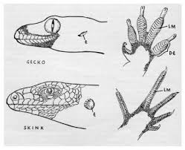
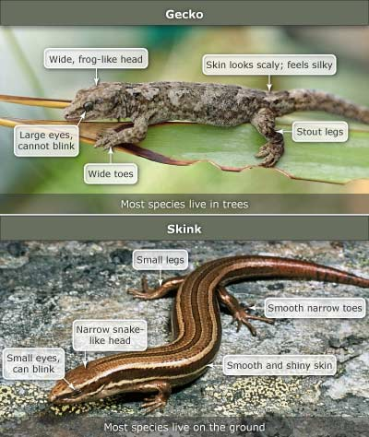
ABUNDANT LIZARDS
Allow lizards to use your buildings, garden plantings and firewood piles for homes.
Diverse gardens are a great food source for native birds and insects.
A 'messy' garden is good for wildlife such as lizards. Rank grass and thick plantings are much better than large expanses of short, mowed lawn.
Keep cats indoors at night.
Put bells on cat's collars.
Encourage your neighbours to trap rats and have wildlife friendly gardens.
Find out more about attracting birds and lizards to your garden.
Minimise the use of sprays, which will kill native invertebrates, and the food source for many native birds and lizards.

Slide 30
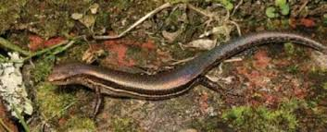
BEWARE THE AUSTRALIAN RAINBOW SKINK
BREEDS FOUR TIMES AS FAST AND IS AGGRESSIVELY TERRITORIAL
VERY AUSSIE !!!
CAME INTO NZ THROUGH AUCKLAND AND HAS BEEN FOUND AS FAR SOUTH AS FOXTON BEACH

Slide 31

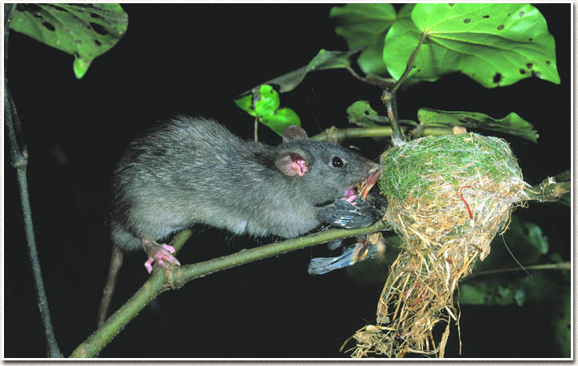
PEST CONTROL
To report vermin, wasp or bees nests in any Porirua City public place, call Council’s Customer Services Centre on 04 237 5089.
For Greater Wellington Regional Council controlled land, call their free phone on 0800 496 734 or visit their website.
For Department of Conservation land, visit the Department of Conservation website from the link below.
3 MILLION DOLLARS IS INVESTED EACH YEAR TO RESEARCH NEW WAYS TO GET RID OF PESTS ,,,
PAPP Tunnels … SODIUM NITRITE feeding …. NOT RATS !!
FERAL CAT TRAPPING

Slide 32
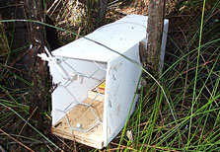
PREDATOR TRAPS
Doc series trapping systems
Double-set box with Doc 150 traps $68.40*
Single-set box with Doc 150 trap $41.25*
Single-set box with Doc 200 trap $45.70*
Double-set box with Doc 200 traps $75.80*
Single-set box with Doc 250 trap $62.70*
The Doc 150, Doc 200 and Doc 250 have passed draft NAWAC (National Animal Welfare Advisory Committee) guidelines as humane kill traps for the pests listed for each trap.
All of the trap boxes are constructed using H4 timber, galvanized weld mesh, galvanized nails,
stainless steel staples and screws.
A| 111 Hutt Park Road, Seaview, Lower Hutt.
Haines Pallet Co. Ltd.
T| 04 568 6898 F| 04 5686480
Setting tool ($25.00 +gst) and “Weka length” boxes available on request.
* theses prices do not include gst & handling

Slide 33
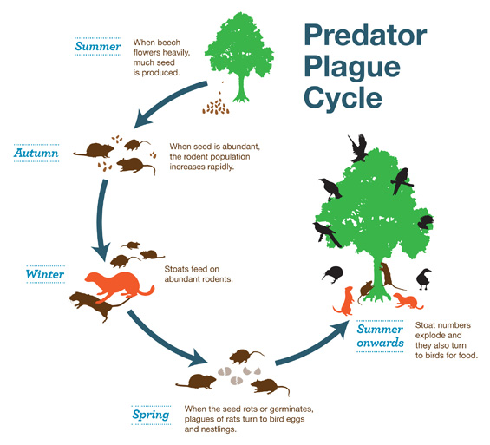

Slide 34
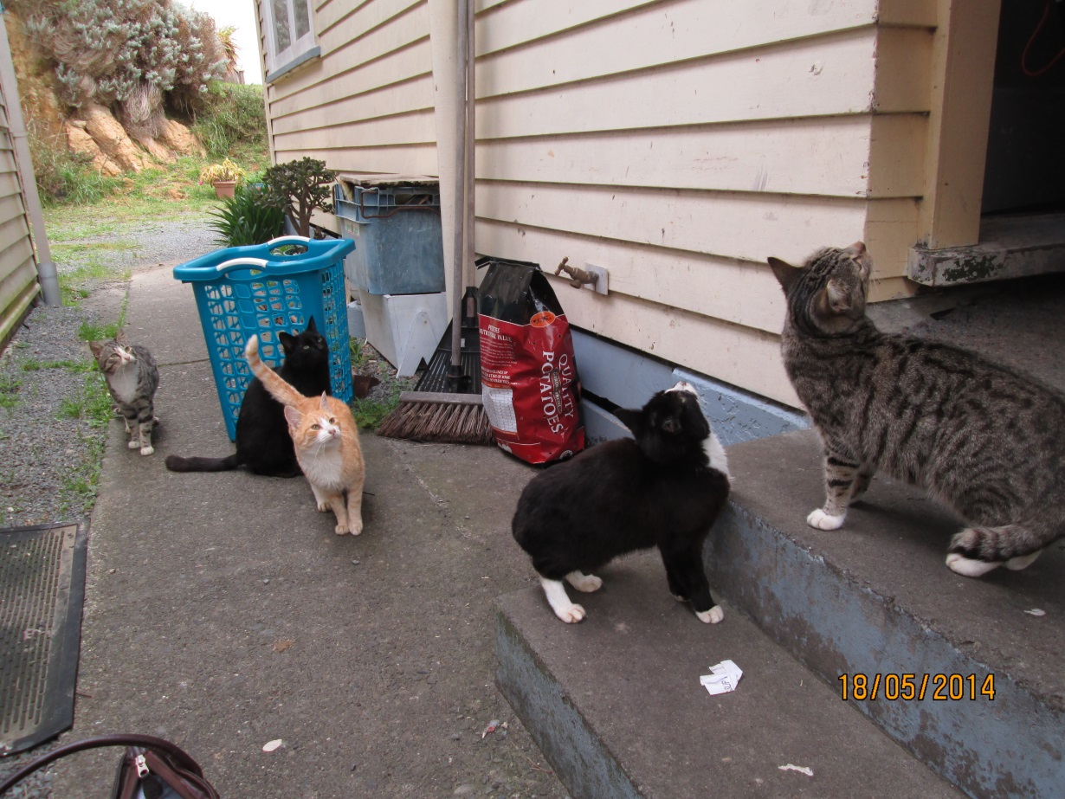
LATEST TUI ADVERTISEMENT ON HUTT MOTORWAY
SHHH I WANT TO HEAR WHAT GARETH MORGAN IS SAYING
YEAH RIGHT !!
A BIRD A DAY KEEPS THE CAT AWAY….

Slide 35


POSSUM CONTROL
There are approximately 70-80 million possums in New Zealand, and they devour nearly 8 million tonnes of vegetation annually.
1080 drops in remote area that are carefullly monitored are the only way we have at present to limit the spread .
Possus can kill a full grown rata tre in three years

Slide 36

CURRENT CHALLENGES
Land development practices allowable by current RMA
Where are the Riparian Strips ?
Where is the dust control and sedimentation limiting factors ?
What is being planted to replace what has been lost ?
Who pays ?
Who does it ?

Slide 37

BIRD CORRIDORS ACROSS FARMLAND ???
This is a view from the Pac n’Save carpark across Keneperu Stream estuary area.
Taken in November j just before Bull dozing and realignment ….

Slide 38

AIDING REGENERATION
This is the North Eastern area of Baxter’s Knob
Soon to be bull dozed into areas of habitable flat squares
. Kohekohe was probably the dominant vegetation cover on Kapiti Island before it was cleared in the early 19th century for cultivation and farming. The kohekohe forest on Kapiti is recovering after possums were eradicated in 1986.

Slide 39

BIRD CORRIDORS
Story Source:
The above story is based on materials provided by Cornell University. The original article was written by Joe Schwartz
http://content.yardmap.org/
http://www.sciencedaily.com/releases/2014/05/140502130118.htm
Google maps heLP TO ORGANISE PEOPLE INTO COLLATING DATA OF BIRD FRIENDLY GARDENS
Creating larger, connected patches of bird-friendly habitat is one goal of the new YardMap citizen-science project from the Cornell University Lab of Ornithology.

Slide 40


